Slide 1
Introduction to MATLAB® Introduction to Matrices
Sriram Krishnamurthy

Slide 2


Basics
Matlab is a GUI based computing software generally used for Engineering applications.
Similar to Wolfram Mathematica
MATLAB stands for MATrix LABoratory
Open Source alternatives:

Slide 3
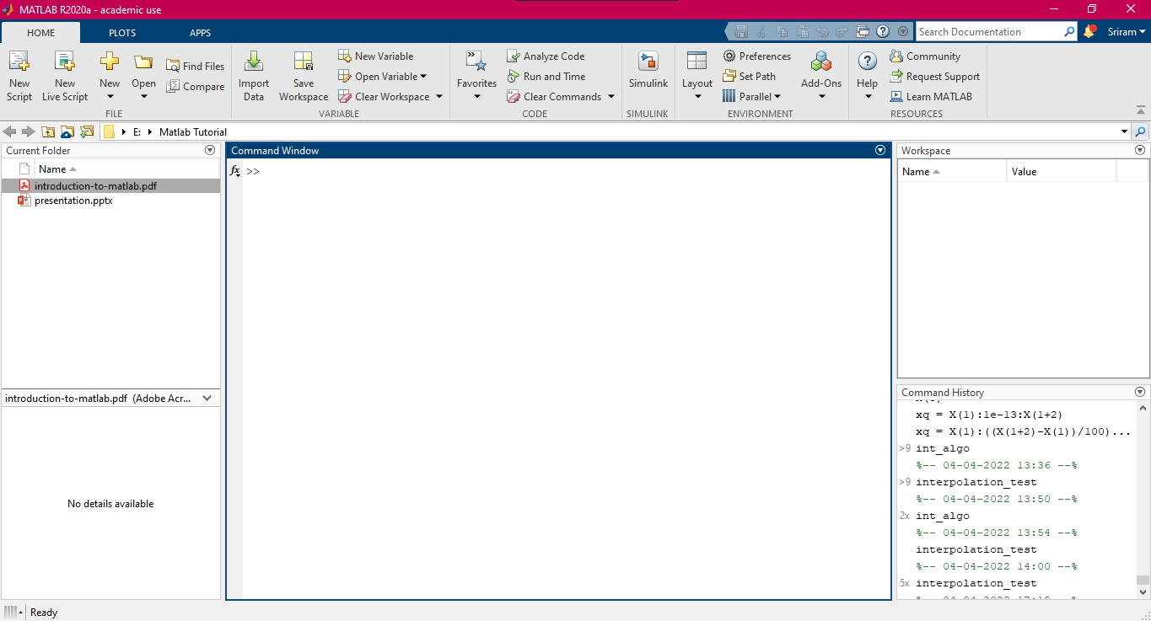
The Command Window

Slide 4
The Command Window
Path
Contents in the current working folder
Details of the
Selected file

Slide 5
The Command Window
Work Space – shows all the variables – very Important
Command History

Slide 6
The Command Window
Commonly Used tools - ToolBar

Slide 7
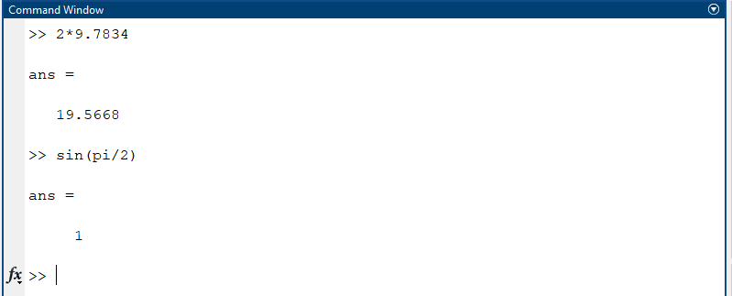
MATLAB – A high performance calculator

Slide 8
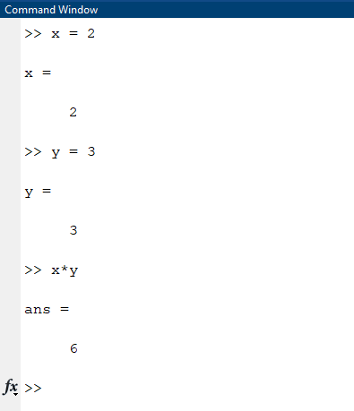
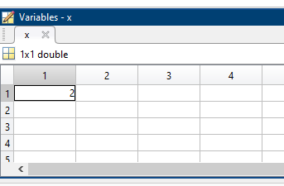
Variables

Slide 9
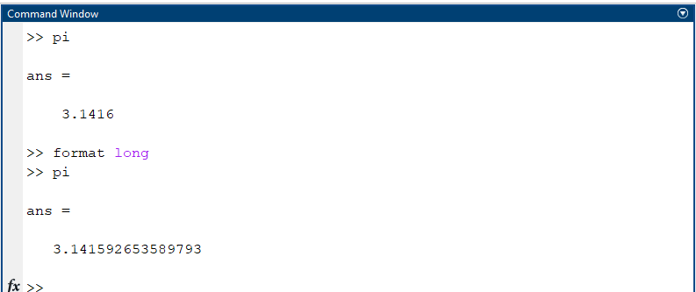
Default format – 4 digits after the decimal (just on the screen!) [format short]
format long – 15 digits after the decimal
(actual value used for calculation)

Slide 10
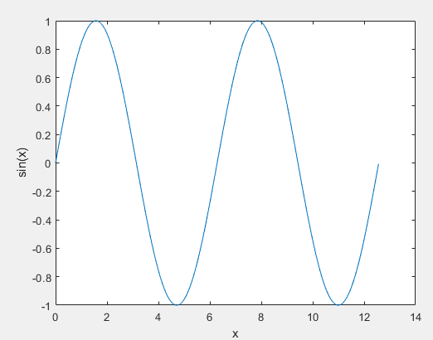
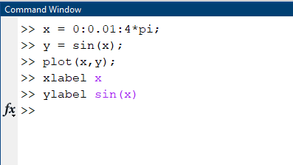
Basic Plotting

Slide 11
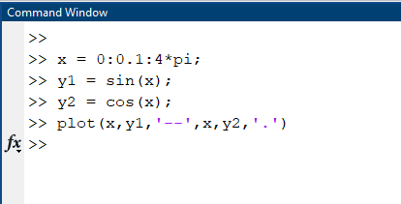
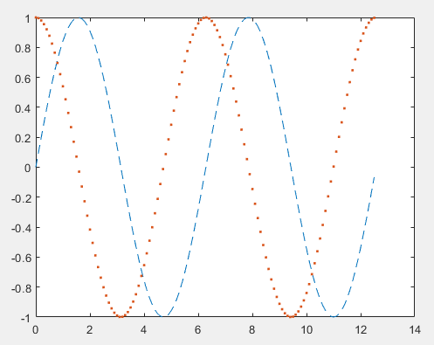
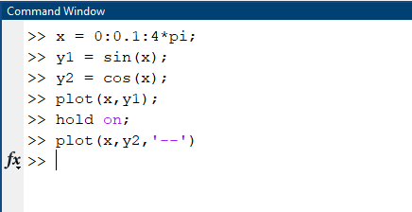
Basic Plotting

Slide 12
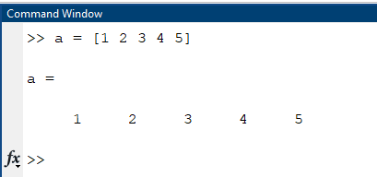
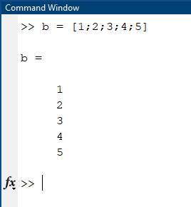
Matrices
Column Vector
Row Vector

Slide 13
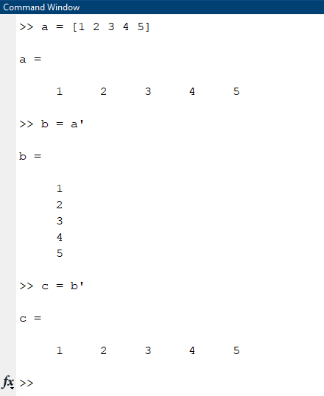
Vector Transpose

Slide 14
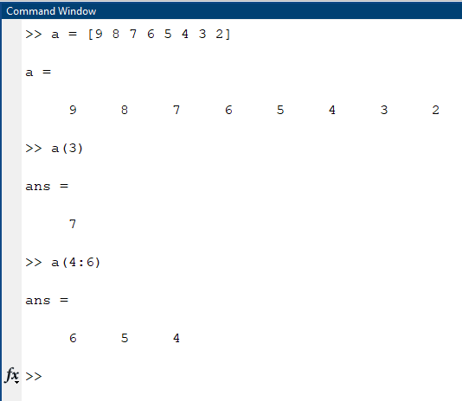
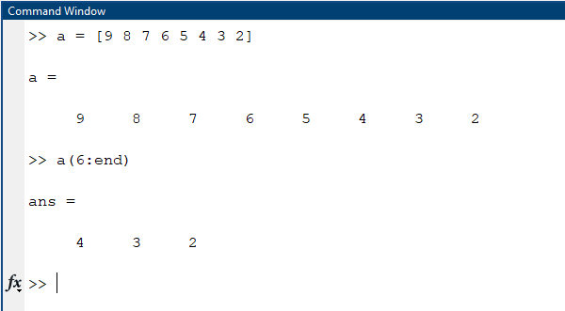
Accessing elements

Slide 15
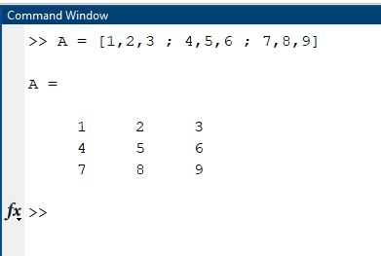
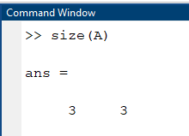
Begin with a square bracket, [
Separate elements in a row with spaces or commas (,)
Use a semicolon (;) to separate rows
End the matrix with another square bracket, ].

Slide 16
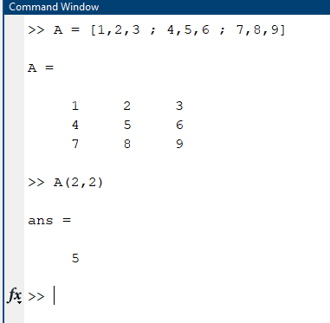
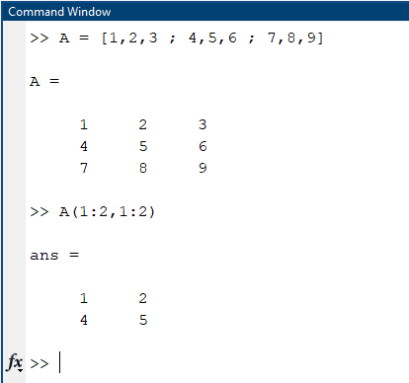

Slide 17
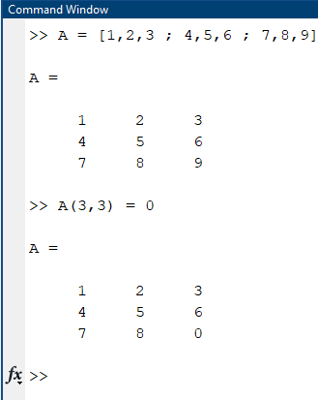
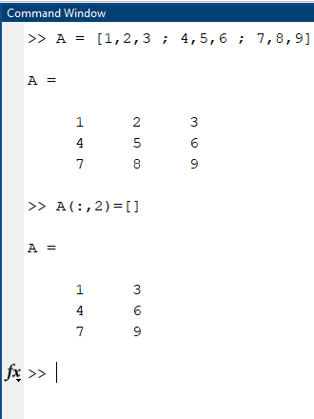
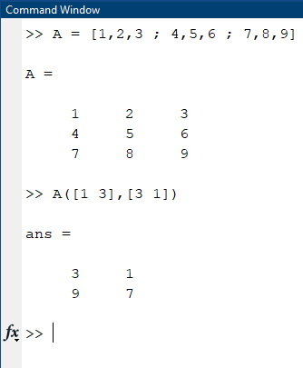
Row 1&3, Column 3&1

Slide 18
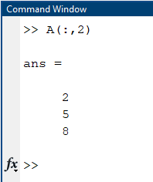
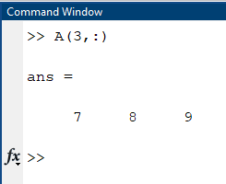
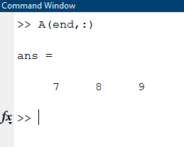
A(:,j) is the jth column of A
A(i,:) is the ith row, and
A(end,:) picks out the last row of A

Slide 19
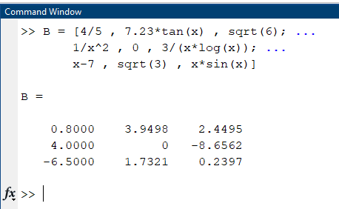
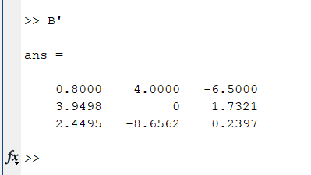

Slide 20
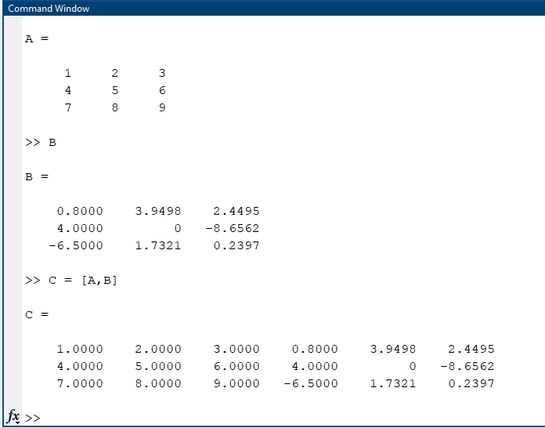

Slide 21
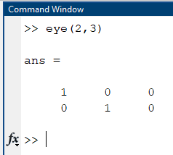
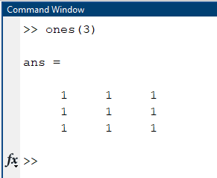
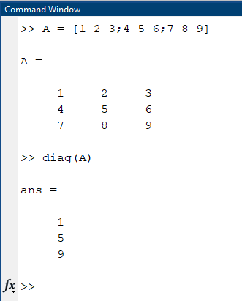
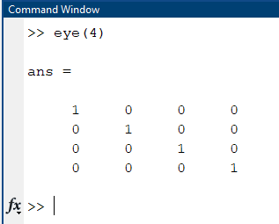
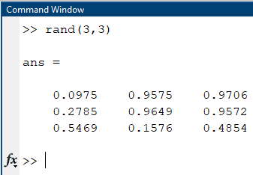

Slide 22
Arithmetic Operations

Slide 23
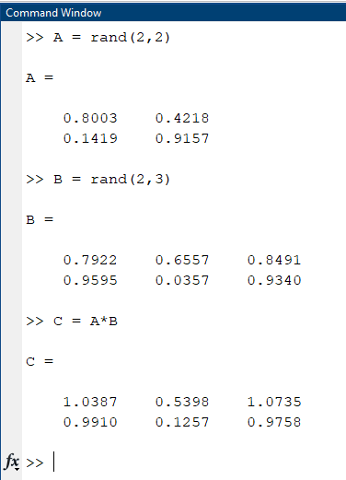
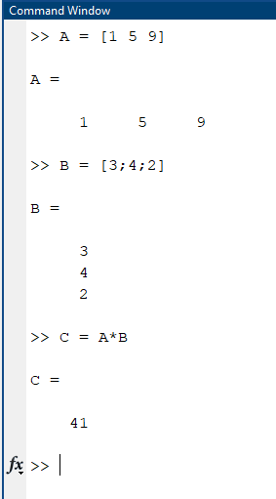

Slide 24
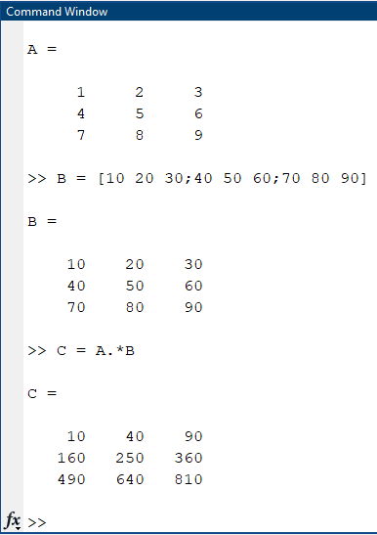
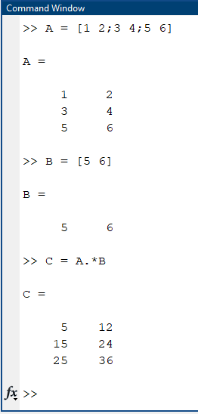
Element by element multiplication

Slide 25
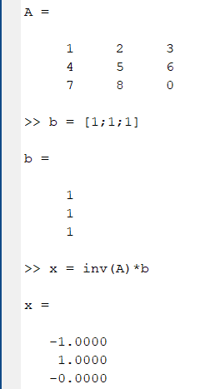
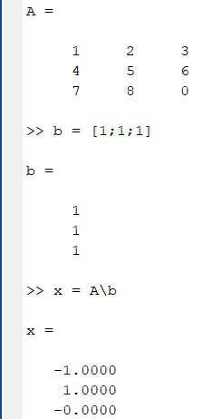

Method 2 Gaussian elimination
Solving Linear Equations
$$Ax=b$$
$$x+2y+3z=1$$
$$4x+5y+6z=1$$
$$7x+8y=1$$
Solution is given by:
$$x=A^{−1}b$$
Method 1

Slide 26
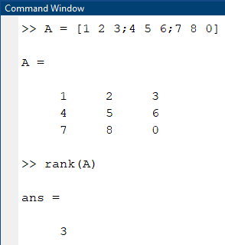
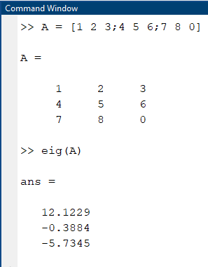
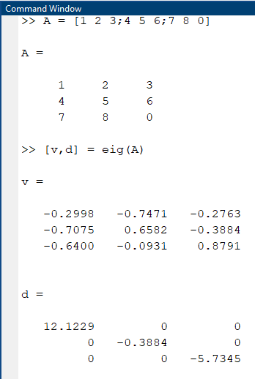
Eigen Vectors
Eigen values

